Slide 1

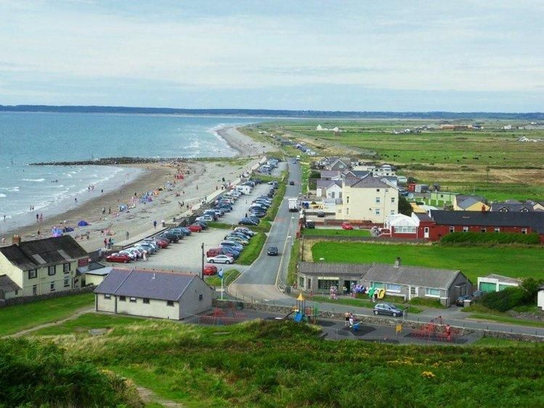
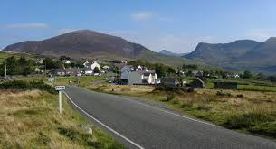
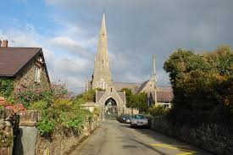
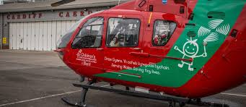
Llandwrog Community Council -Annual Report 2019-20

Slide 2
A Word from the Council Chairman
Councillor Alun Wyn Jones – Council Chairman 2019-20.
This Report is an important element of Llandwrog Community Council's arrangement to connect with the area's rate-payers to explain its accomplishments and use of the budget during the 2019/2020 financial year whilst drawing attention to some plans for 2020/2021.
It is hoped that publishing this Report can improve rate-payers' understanding of the community council's scope of operation and strengthen the relationship between rate-payers and their council.

Slide 3

Council Budget 2019-20
Expenditure £60,948 £69,997 yn 2018-19, cynnydd o 20%
Less Paecept Income (£55,000) (£48,000) in 2018-19
Less Income from Fees (£7,608) (£9,342) yn 2018-19
Balance carried forward to ist April 2020 (£11,006) (£9,346) yn 2018-19
Council Funds as at 31 March 2020 –
Contingency Fund (£5,000) (£5,000) yn 2018-19
Playing Field Renewals Fund (£2,000) (£1,000) yn 2018-19
Funds Earmarked for 2020-21(£4,285) (£3,345) yn 2018-19
Council Debts as at 31 March 2020 £126,200 (1 Purchase of land at Bryn’rodyn in 2006 £7,250 2) Cemetery Footpaths in 2006 ££39,069 3) New cemetery Bryn’rodyn 2014 £79,881

Slide 4
Work Undertaken by your Council during 2019-20
Subject
Managing The Council’s Property
Administraton & Governence
Financial Contributions to Voluntary Organisations
National Eisteddfod Llyn & Eifionnydd 2021
Representing Your Community
Partnerships & Joint Working
Consulting With the Community
Planning Applications
Improving Our Villages & Our Community

Slide 5
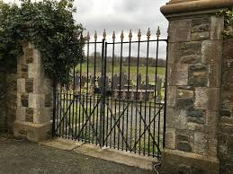
Managing Council’s Property
A comprehensive program of works has been undertaken in the parish churchyards of Llandwrog, Carmel and Bryn'rodyn cemeteries to improve the appearance of
A new bus shelter was installed at Cae'r Moel, Carmel following an accident
An agreement was reached with the Carmel Village Committee to improve access to the bus shelter located in the community garden car park.
A new gate has been installed at the entrance to Y Fron football field.
Health and safety checks was carried out on the condition of headstones at Bryn'rodyn cemetery.
An agreement has been reached with BT to purchase the Dinas Dinlle telephone cabin with the option of installing a defibrillator in the future.
Discussions took place with Gwynedd Council to take responsibility for playing fields at Fron, Carmel and Dinas Dinlle

Slide 6
Administration & Governence
Environment & Biodivesity Policy was adopted
On Line Payments & Banking Policy was adopted
Use of Community Playing Fiels Policy was adopted
Financial Contributiond to Voluntary Organisations Policy was adopted
A series of meetings were held to review the Council's Standing Orders. The Rules were adopted in February 2019
The Council agreed to contribute to the Manager's Pension Scheme to comply with "Auto Enrollment" Rules. The Council contributes 10% of the Manager's salary to the NEST pension scheme

Slide 7
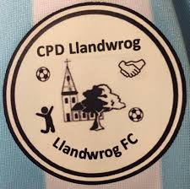
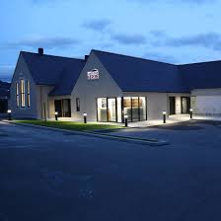


Financial Contributions to Voluntary Organisations
A total amount of £4,500 to 18 organisations varying from £100 to £1,000
A grant was offered of £100 to each village in the community to hold activites to celebrate Victory In Europe Day on the Bank Holiday weekend on Friday 8 May 2020

Slide 8

National Eisteddfod Llyn & Eifionydd 2021
A letter has been received from the National Eisteddfod Office that our community is expected to contribute a sum of £5,000 as part of a wider target of £ 400,000 which has been set on the Area Committee.
The Community Council is asking the villagers of Fron , Carmel, Groeslon , Llandwrog & Dinas Dinlle to set up a committee or committees independent of the Council to organize fundraising activities.
The Eisteddfod Office expects every community to create an atmosphere of activity and events for a period of eighteen months that will raise everyone's awareness that the Eisteddfod is coming to the area.

Slide 9
Representing Your Community
Members & Manager of the Community Council represented your community on various Groups and Meetings over the year. These are examples
Moel Tryfan ac Alexandra Quarry Engagement Group
Grŵp Delwedd Dyffryn Nantlle
Ysgol Bro Llifon
Prosiect Partneriaeth Glynllifon Partnership Project .
Bu i’r Rheolwr dderbyn gwahoddiad i ymweld RAF Fali ynglŷn aflonyddwch ymarfer hedfan dyddiol dros ein cymuned, Pwyllgor Ardal Un Llais Cymru (chwarterol)
Grŵp Cludiant Cymunedol Dyffryn Nantlle Transport Strategy
Grŵp Cynefin – Strategaeth Bro Lleu Strategy
Gwefan (Website) Bro 360

Slide 10
Partnership & Joint Working
Partnership agreement with Gwynedd Council to ensure all the community's salt bins are full
Commitment to partner with Gwynedd Council to keep the Marine Toilet, Dinas Dinlle open up to 31 March 2021.
Continue to work with the Diocese to maintain the grass of the St Thomas’s Churchyard , Groeslon
Joint Working with Snowdonia National Park on the Euuropean Grant Funded Uwch Gwyrfai Common project. The project strives to improve the common , create firebreaks, improve access. In 2020 work is expected on the Lon Cim to Warmlee to clear bramble and to open two wells which have been lost due to neglect

Slide 11



Consulting With The Community
Every household in the community were consulted to find out their views and opinions regarding their concerns and aspirations and to analyze the results and commission a report. 403 responses were received. The Community Council intends to use the analysis of the report taking into account, where appropriate, those aspects that will drive its programme of work over the next two or three years.
A new website was commissioned which will go live in the Spring 2020 – cyngorcymundllandwrog.cymru

Slide 12

Planning
Number of applications received & decisions mad by the Council 40

Slide 13
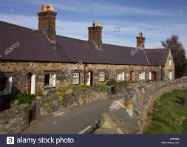
Schedule of Works 2020-21
Restoration work at Bryn'rodyn and Llandwrog cemeteries
Opening of the new Bryn'rodyn cemetery
Identify location and funding to install a bus shelter in Dinas Dinlle
Correspond via social media
Undertake a survey of all public rights of way in the community to identify any works required to keep them open
Identify sites in the community to promote biodiversity in accordance with the Environment (Wales) Act 2016 (all Town and Community Councils have a duty to maintain and enhance biodiversity and promote ecosystem resilience)
Continue to identify community needs through an engagement process
Steer the Council through changes to the Community Council's arrangements following the Welsh Govenments Local Government and Elections Bill
Mapping the burial sites of the three community cemeteries electronically
Continue to press Gwynedd Council to reverse its decision to charge a parking fee in Dinas Dinlle
Continue to press Natural Resources Wales to carry out footpath works at Dinas Dinlle, as well as improving the condition of our roads
Assist any committee/s in reaching the community target of £ 5,000 as a contributor to the Llyn and Eifionydd National Eisteddfod 2021

Slide 14
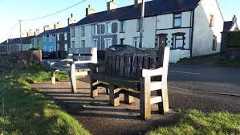
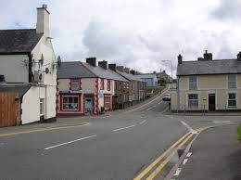
Improving our Villages….. examples of what your Council did in during the year
Public Transport – additional services to Cae Sarn, Groeslon and Fron/Carmel to Caernarfon & Penygroes
Dog Bins - additional dog bins in Carmel and Llandwrog.
Parking Charges at Dinas Dinlle - A senior Manager from Gwynedd Council was invited to meet with members to show our opposition to Gwynedd Council's intention to charge parking fees in Dinas Dinlle.
Continuing to put pressure on Gwynedd Council and Natural Resources Wales to secure a footpath along Dinas Dinlle beach
Road Maintenance – following pressure on Gwynedd council new road surfacing was carried out I Llnadwrog, Carmel and Fron
New notice board was installed in Llandwrog
Successfully acquired Mobile Postal Service at Y Fron
Co-operated with Ysgol Bro Llifon to ensure use of the Groeslon football pitch for village children out of school hours.
Maintains four cemeteries, two football fields, ten bus shelters within the community
Maintains the network of public footpaths within the community

Slide 15

Council Meeting 2020-21
Number of Full Council Meetings 12
Number of Committee and Working Group Meeting 16
Number of Public Meetings 1
Number of complaints received 2 (Bryn’rodyn cemetery)
New Members during the year 2
Resignations in during the year 1
Number of members that claimed an annual allowance of £150 dim

Slide 16
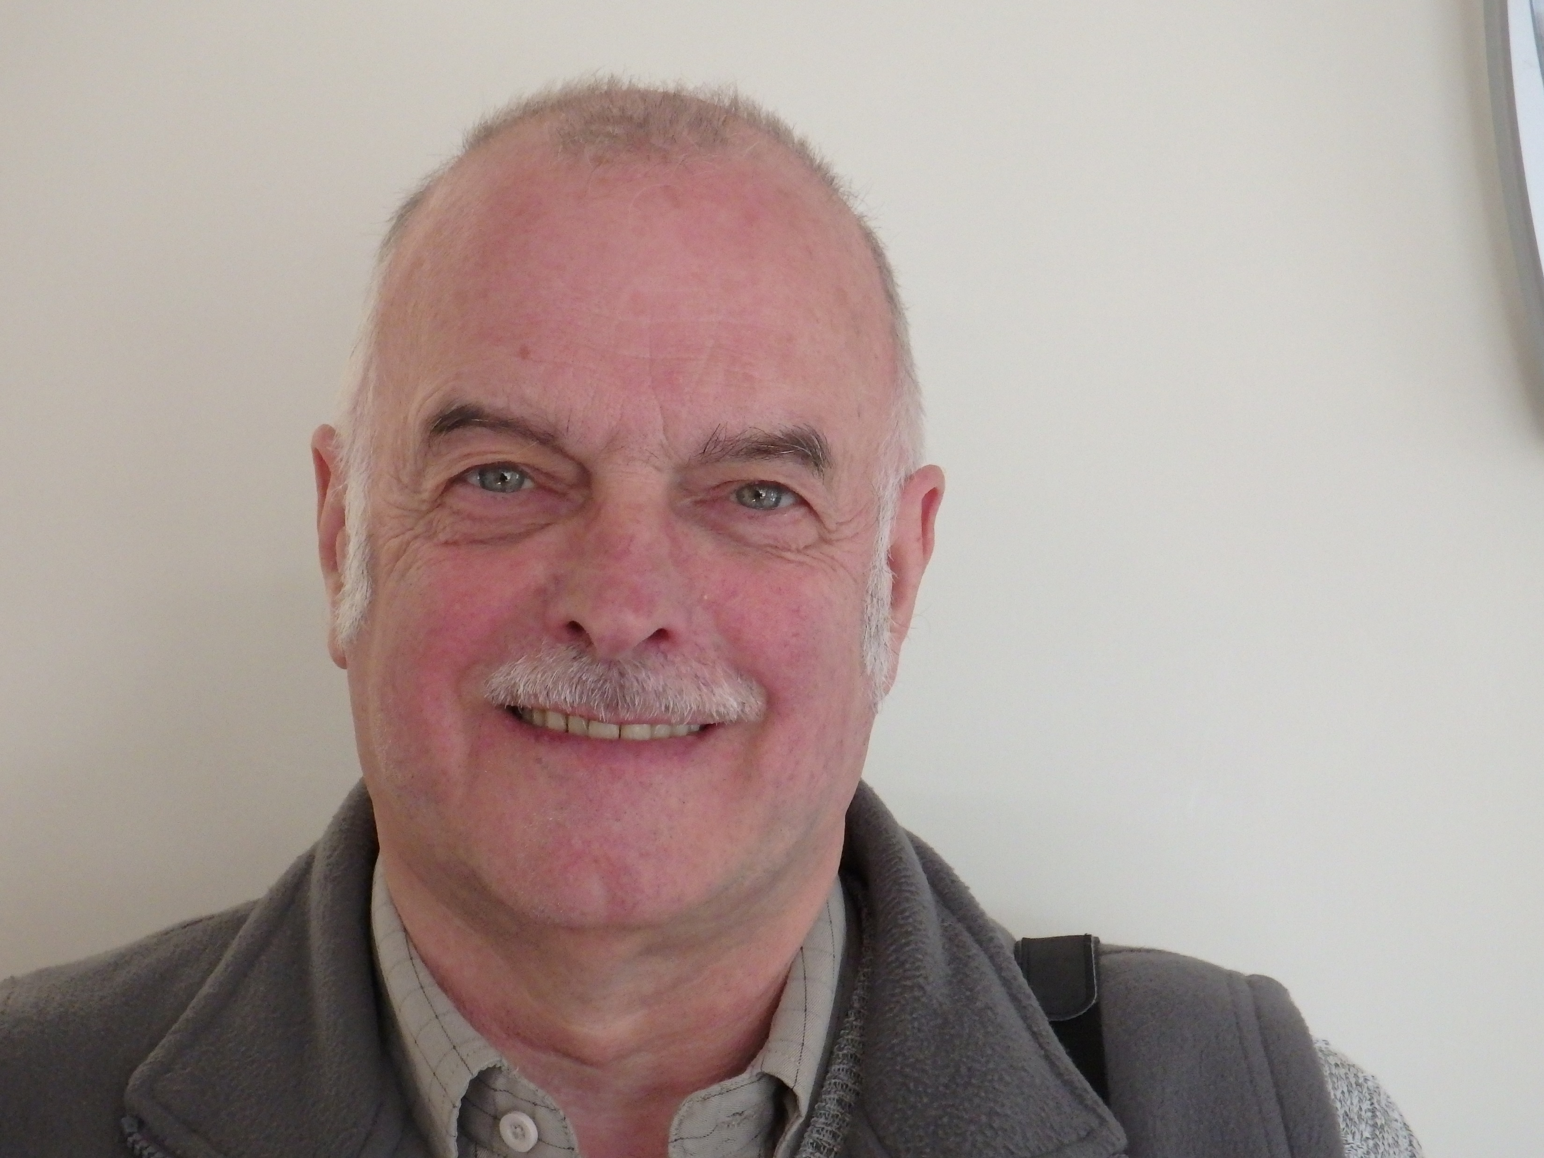
Your Representatives – Carmel Ward number of seats 3
Councillor Alan Patterson Bryn Llifon, Carmel, Caernarfon, Gwynedd LL54 7RW Tel 01286 881843 neu 07989 906704 Member since October 1995
Councillor Bryn Williams Dafarn Dywyrch, Llandwrog Uchaf, Caernarfon, Gwynedd LL54 7RA Tel 01286 831378 or 07583 517852. Member since April 1997
Councillor. Helen Hughes Wenallt , Carmel Caernarfon, Gwynedd LL54 7RP Tel 01286 881863 Member since May 2016

Slide 17
Your Representatives – Fron Ward number of seats 2
Councillor Gwyn Owen Jones Bodwyn, Y Fron, Caernarfon, Gwynedd LL54 7RB Tel 01286 881138 or 07790 333260. Member since February 1997
Councillor Rhys Vaughan Thomas, Gwynfa, Rhos Isaf, Caernarfon, Gwynedd LL54 7NN Tel 07765 055224 Co-opted as a member February 2020

Slide 18
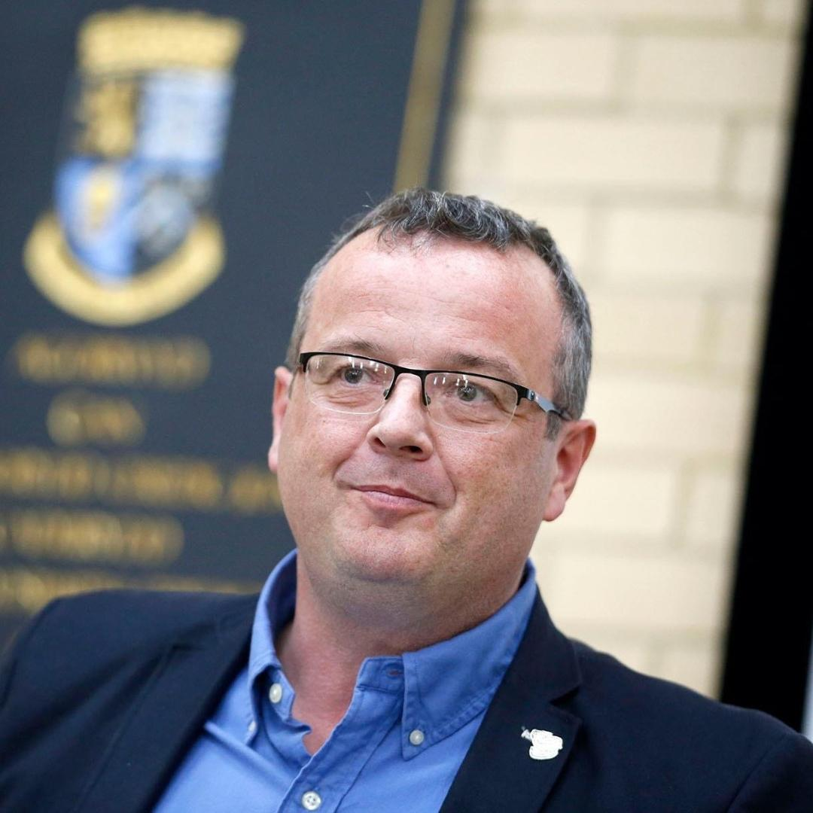
Your Representatives – Groeslon Ward – number of seats 6
Councillor Alun Wyn Jones Hafan, Rhes Grugan, Y Groeslon Caernarfon, Gwynedd LL54 7TD Tel 01286 830911 Member since January 1986
Councillor Hywel John Owen Sycharth, Cae Sarn, Y Groeslon Caernarfon, Gwynedd LL54 7TW Tel 01286 830006 or 07979 985149 Member since September 1983.
Councillor Gerwyn Owen 4 Cae Sarn, Y Groeslon Caernarfon, Gwynedd LL54 7TW Tel 07979 045744 Member since October 2014
Councillor David C Davies Bodarfryn, Dolydd, Y Groeslon Caernarfon, Gwynedd LL54 7EF Tel 07836 325195 Member since June 2017

Slide 19
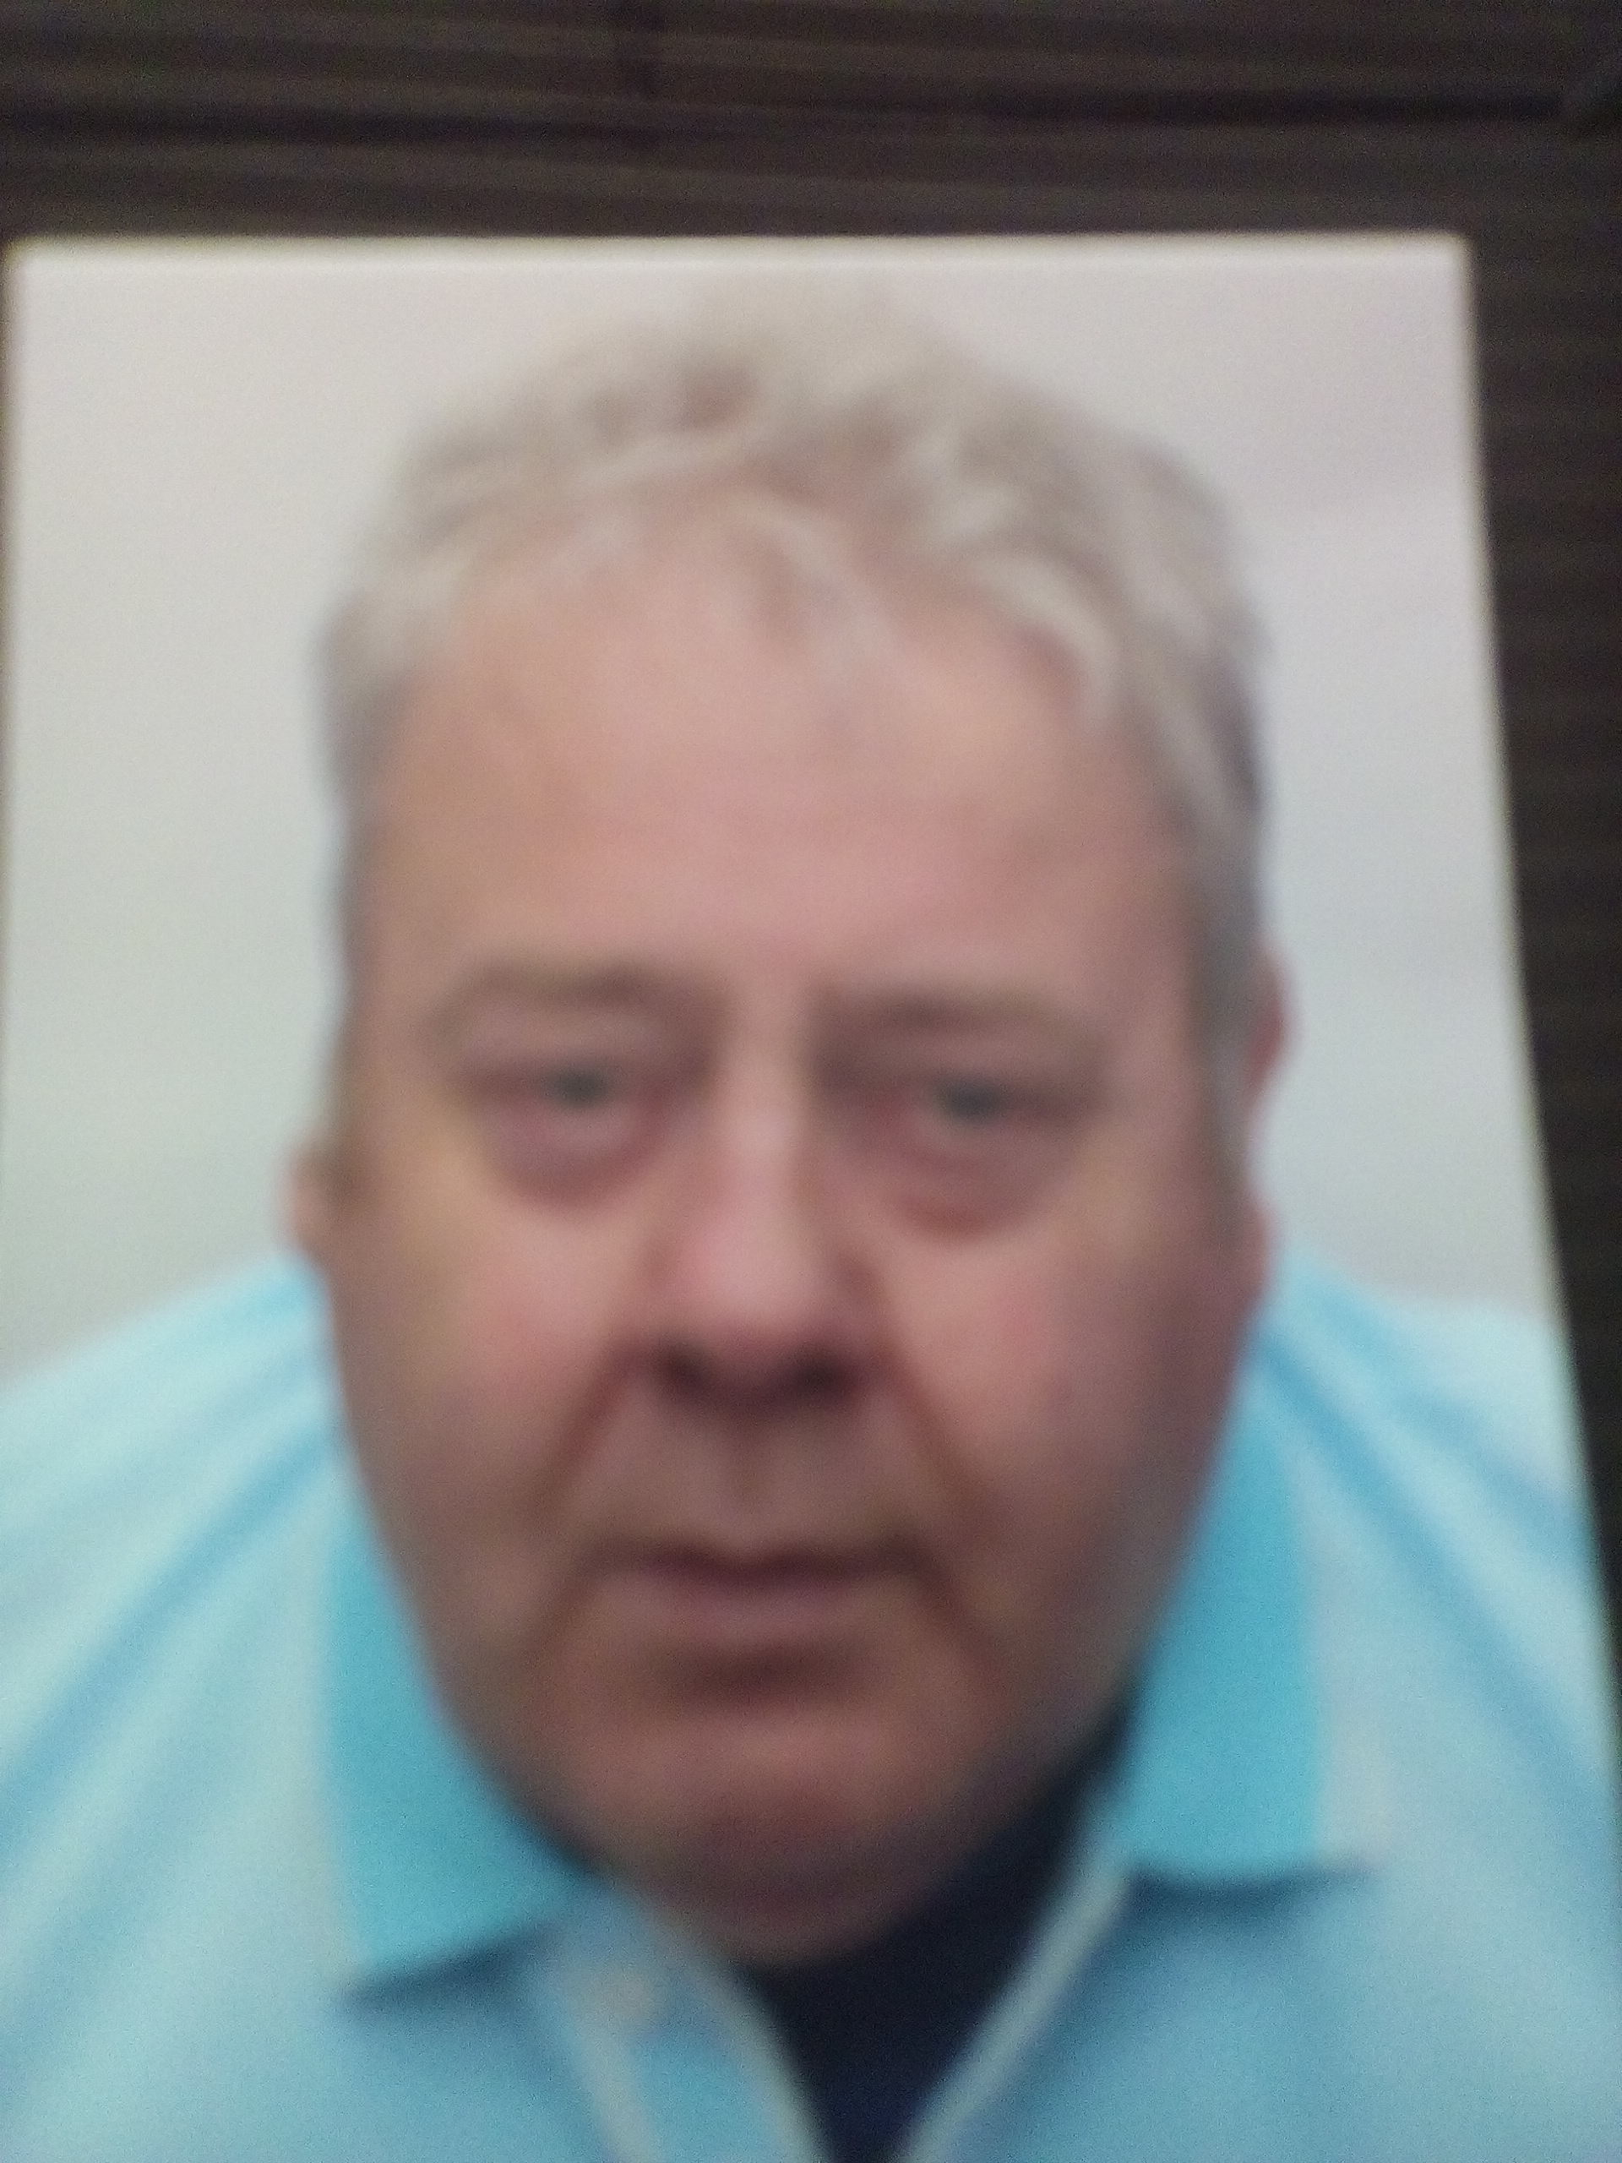
Your Representatives – Groeslon Ward
Councillor Robert Jones 1 Bryn y Neuadd, Y Groeslon Caernarfon, Gwynedd LL54 7ST Tel 07788 570106 Member since December 2013
Councillor Eddie John Willcox Noddfa, Y Fron Caernarfon, Gwynedd LL54 7BB Tel 07919 914483 Member since May 2017

Slide 20
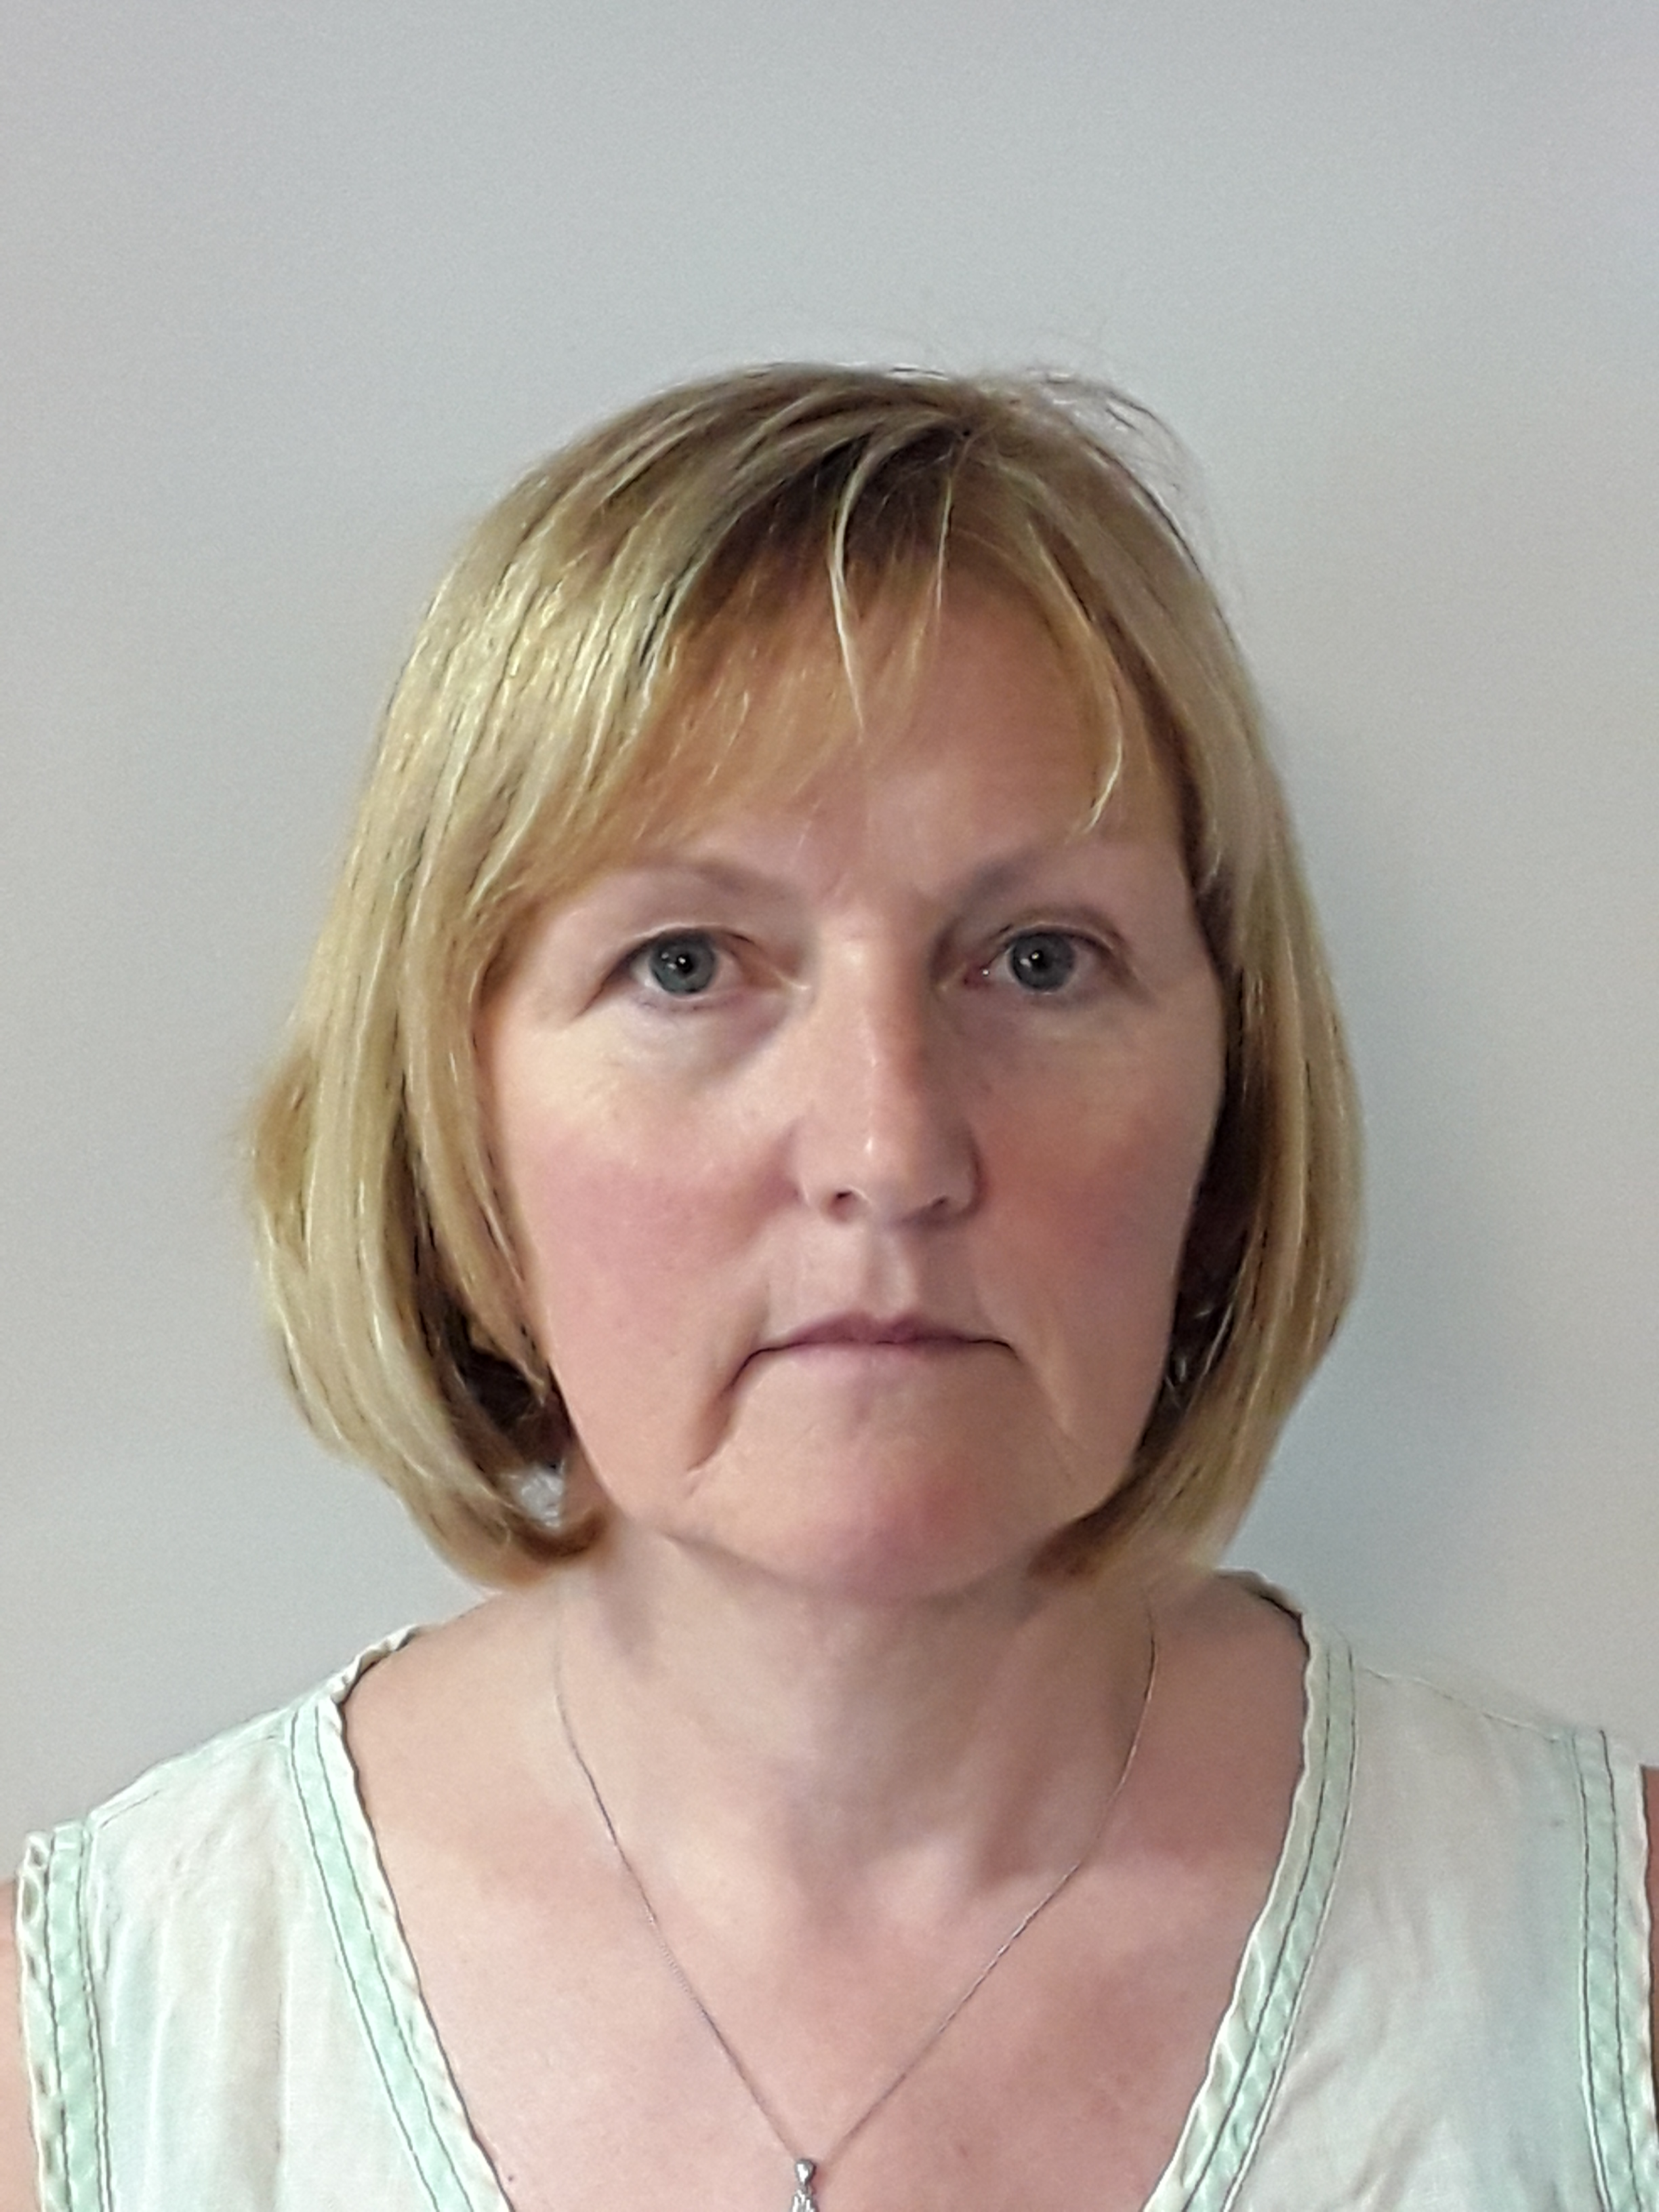
Your Representatives - Llandwrog/Dinas Dinlle Ward - number of seats 3
Councillor Clive Bayley Ty Clen, 1 Gernant, Bethesda Bach Caernarfon, Gwynedd LL54 5SJ Tel 07967 794002 Member since June 2017
Councillor Dyfed Williams Bwthyn Henryd. Llandwrog Caernarfon, Gwynedd LL54 5TN Rhif ffôn 01286 831290 neu 07772 819189 Member since May 2012
Councillor Marnel Pritchard Llain yr Eglwys, Llandwrog Caernarfon, Gwynedd LL54 5TA Tel 01286 830993 Co-opted as a member February 2020

Slide 21
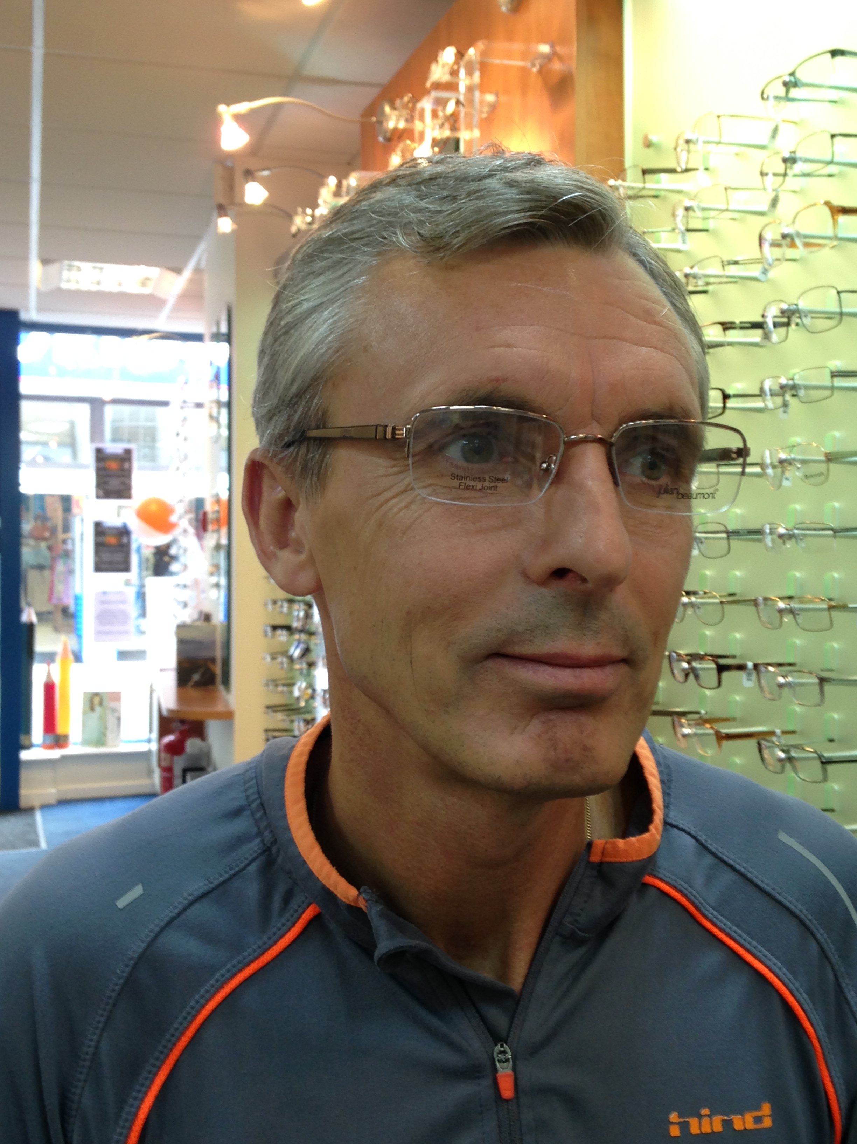
Contacting Your Council
Administration & Finance Manager
    David Roberts, Bryn Meurig, Carmel , Caernarfon Gwynedd LL54 7DS
Telephone 01286 881920 or 07796 024288
E-Mail gwybodaeth@llandwrog.org
Council Webste llandwrog.org
Business Hours – the Manager works part-time sfor the Council. You can contact the manager by post, phone o’r email or at his home address. Do remember that you can also contact your Community Councillor and also your County Councillor.

Slide 22
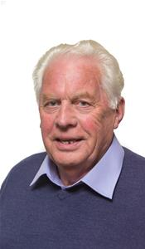
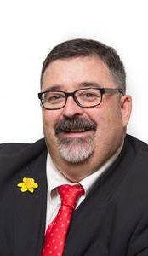
Your County Councillors
Councillor Eric Jones Afallon, Groeslon, Caernarfon, Gwynedd, LL54 7TU Tel: 01286 830626 Mobile: 07469 215011 ryn cynrychioli ward Y Groeslon, Llandwrog a Dinas Dinlle Ward ebost ericmerfynjones@gwynedd.llyw.cymru
Councillor Dilwyn Ifor Lloyd Eryri House, Carmel, Caernarfon, Gwynedd, LL54 7AB Tel 01286 882149 representing Ward Y Fron a Carmel email Dilwynlloyd3@btinternet.com

